Slide 1

Web Data Analytics
MGMT - 59000
Predicting Consumer Tastes with Big Data at Gap (517115-PDF-ENG)
October 4th 2023
Team-13:
Habib, Farzooq
Singh, Akanksha
Vats, Samridhi
Wang, Alex B

Slide 2











Business Problem
Even with a history of defining America’s fashion, GAP Inc., one of the leading retail brands now struggles with their business growth and navigating the creative vs data space
With the recent event of firing Creative Directors, it is imperative to understand if the CEO, Art Peck made the right decision.
What data sources can be used over the web to boost the Product 3.0 strategy?
Competitive Landscape
Should Gap Inc follow the same strategy across Gap, Banana Republic and Old Navy?
Art vs Science, how do we make a choice?
source: Predicting Consumer Tastes with Big Data at Gap (517115-PDF-ENG)

Slide 3
A multi-pronged approach has been adopted to analyze the current scenario and assess the capabilities of data
Approach
Get financial data to to understand any shifts in Gap’s performance with the change in creative strategy
Analyze what customers are saying about GAP and its competitors
Realize the difference in the three brands at play
Understand how the competitors with and without a creative director fair against Gap
Analyze what fashion styles are currently trending and selling

Slide 4






Multiple sources can be accessed to analyze the pulse of customer and redefine style
Data Sources
Social media websites for keywords and feedback on brands
E-commerce platforms for reviews, sentiments & top sellers
Google trends and analytics to extract trending keywords
Collaborate with fashion forecasting agencies
Product information across the three brands to identify differences

Slide 5
How do we assess if Gap benefits from the big data approach over the Creative director?

Slide 6
GAP has been performing low despite the major changes made in the organization
Analysis
Annual Net Income for GAP ($ in millions)
Annual Net Income for American Eagle ($ in millions)
12.7% | -1.4% | -27.0% | -26.5% | 25.4% | 18.2% | -65.0% | -289.4% | 138.4% | -178.9%
52.6% | -64.2% | -3.6% | 172.5% | -2.8% | -3.8% | 28.4% | -27.1% | -209.4% | 301.0%
Competitor analysis: American Eagle with a creative director can be seen showing steady growth and a more stable performance when compared to Gap Inc,
source: sec.gov.us

Slide 7

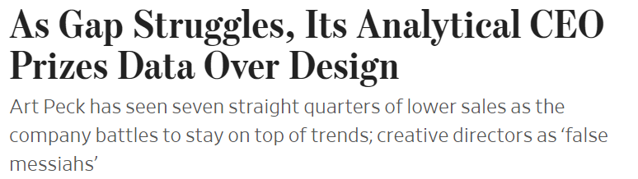

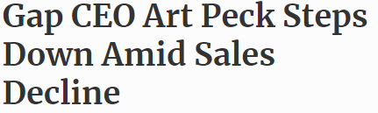

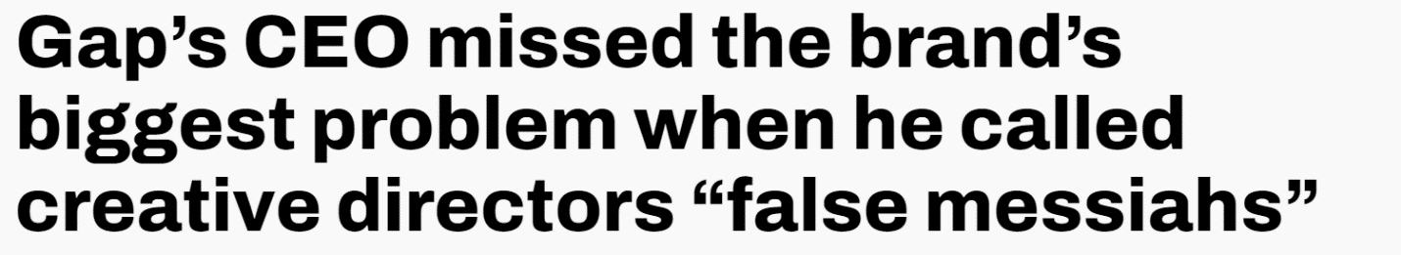
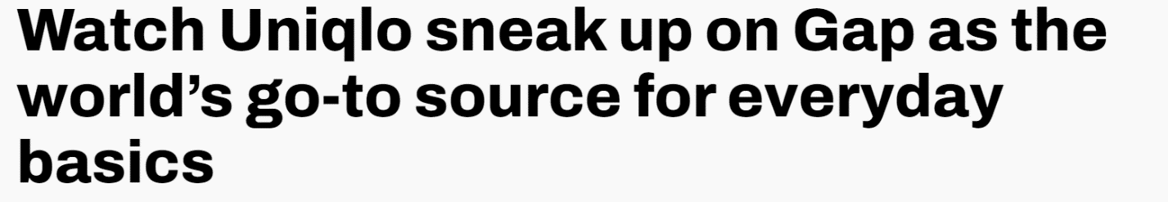
Critics are also wary of the new approach adopted by GAP and do not see any positive outlook
Analysis
source: https://www.wsj.com/articles/as-gap-struggles-its-analytical-ceo-prizes-data-over-design-1480282911
https://www.forbes.com/sites/laurendebter/2019/11/07/gaps-ceo-art-peck-is-stepping-down/?sh=131a8797f10f
https://qz.com/429796/watch-uniqlo-sneak-up-on-gap-as-the-worlds-go-to-source-for-everyday-basics
https://qz.com/846941/gaps-ceo-art-peck-missed-the-brands-biggest-problem-when-he-called-creative-directors-false-messiahs

Slide 8
What is there on the web to feed a data-driven creative model?

Slide 9
Information about the key trends can be extracted from best sellers' pages on various e-commerce stores such as Amazon
Regression Modelling
Keyword | Occurrence
Sleeve | 62
Pullover | 61
Long | 61
Sweatshirts | 59
Tops | 43
Casual | 40
Womens | 39
Oversized | 39
Hoodies | 39
Zip | 39
Fall | 37
Sweatshirt | 35
Women's | 34
Fleece | 30
Clothes | 28
Women | 28
Crewneck | 24
Hoodie | 21
Fashion | 19
Features | Coefficients
Fleece | 0.05358699
Product Sizes | 0.05165633
Hoodies | 0.050942757
Oversize | 0.016560041
Product Price | 0.009370684
High Rise | 0.004255074
Baggy | 0.003941086
Pockets | 0.00352115
Product Colors | 0.001182131
Cropped | 0.000799225
Jeans | -0.038569748
Jeggings | -0.045627063
Crewneck | -0.045824454
2/3rd hoodies are long on the best sellers
43% of the products have a zip
A regression analysis can show which features contribute towards a better rating on Amazon
source: Amazon best sellers page for Women’s hoodies; extracted 10/3/2023

Slide 10
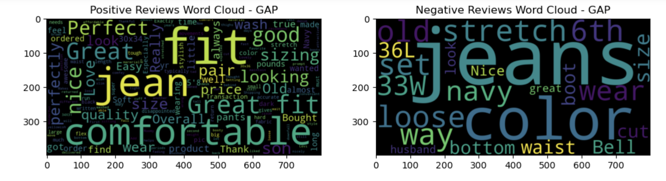
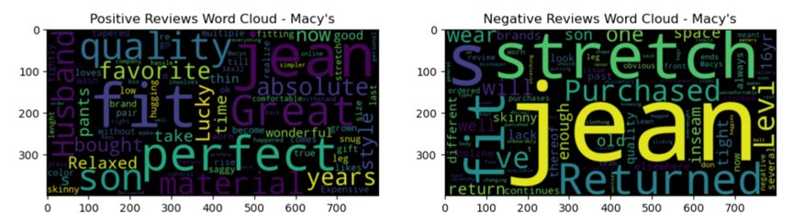
In-depth sentiment analysis can be conducted to get the feedback on various products and compare with competitors
Sentiment Analysis
Reviews analysis: Positive and negative words can be picked from both Gap and other competitors like Macy’s in product design and improvement
source: Men’s jeans reviews from Gap and Macy's websites

Slide 11
Google trends can also be utilized to have a sneak into consumer behavior and their inclination
Keywords Analysis
Keyword | Search Score
black jeans | 100
mens jeans | 93
skinny jeans | 81
men jeans | 80
blue jeans | 79
womens jeans | 78
white jeans | 62
levis jeans | 52
ripped jeans | 50
best jeans | 48
american eagle jeans | 46
mom jeans | 44
levi jeans | 39
denim jeans | 39
jeans for women | 34
wrangler jeans | 33
jeans for men | 33
Keyword | Search Score
mens shorts | 100
nike shorts | 93
womens shorts | 67
women shorts | 65
black shorts | 54
short shorts | 52
white shorts | 45
jean shorts | 44
biker shorts | 38
youtube shorts | 36
girls shorts | 28
cargo shorts | 28
blue shorts | 28
denim shorts | 27
running shorts | 26
swim shorts | 25
bike shorts | 23
basketball shorts | 22
lululemon shorts | 22
Black jeans are the most searched
Black is the most popular color
Ripped jeans is an ongoing trend
source: google trends for the last 5 years across US

Slide 12
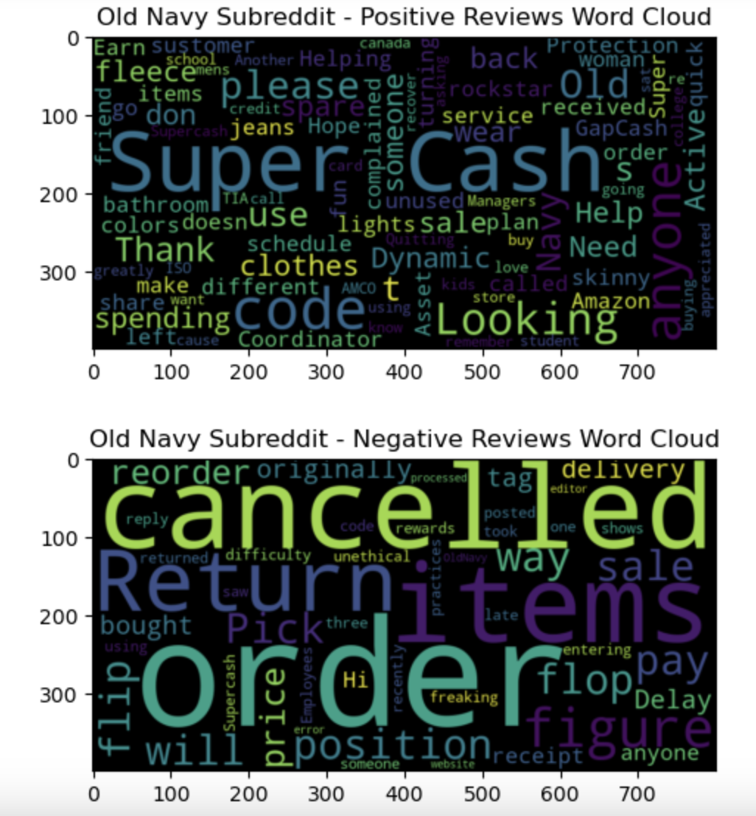
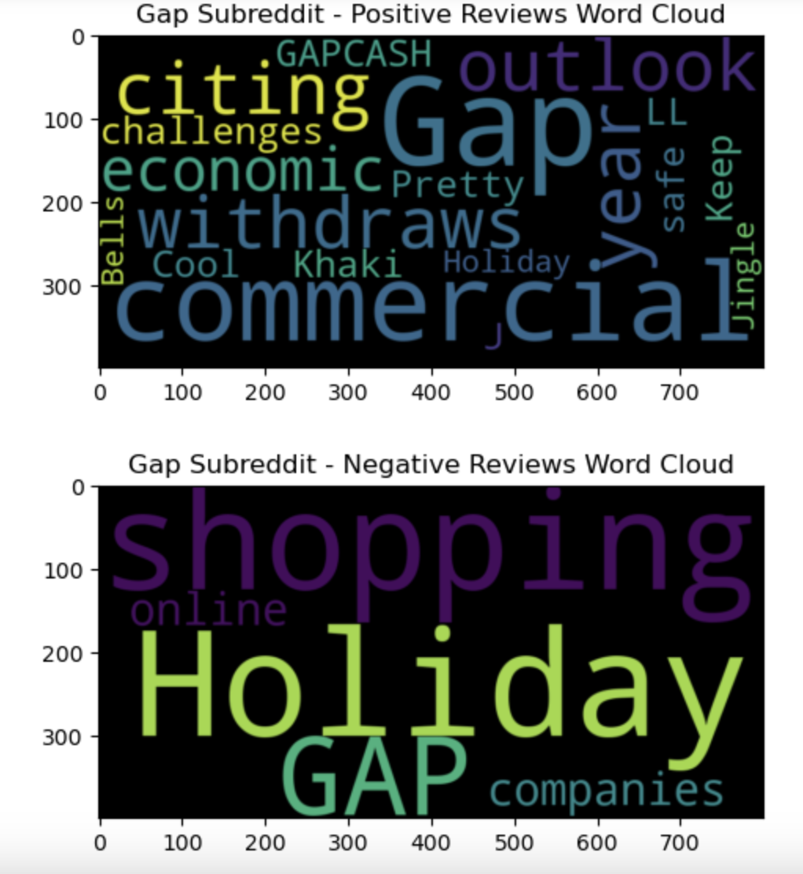
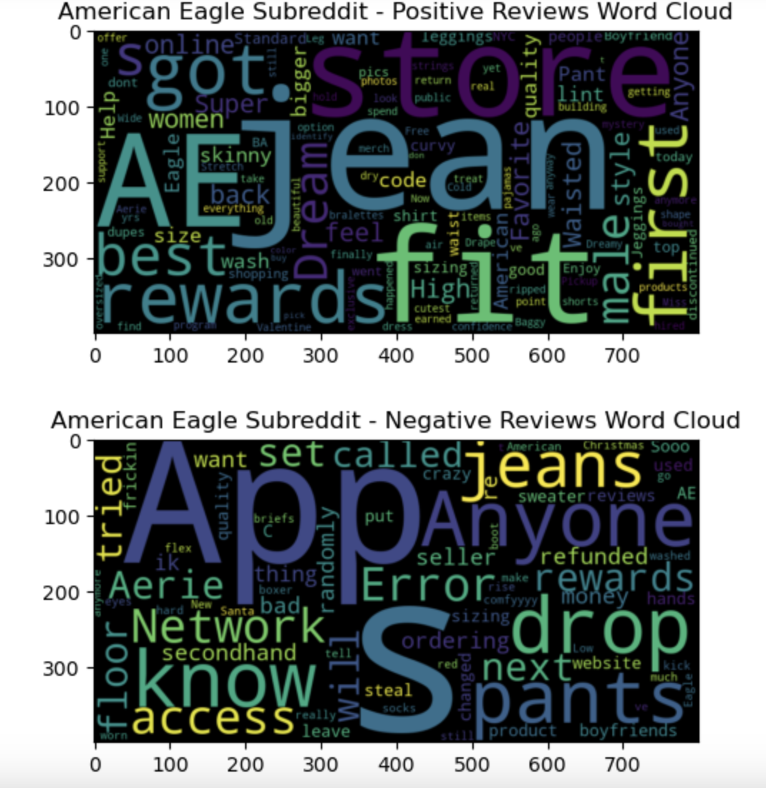
Popular micro-blogging platforms such as Reddit can be accessed to derive valuable insights
Sentiment Analysis
Reviews analysis: Consumers are talking a lot more about the product in the case of American express whereas the focus is more on the sales and services for Gap and Old Navy
source: Sub-Reddit channels: r/Oldnavy , r/GapInc, r/americaneagle

Slide 13
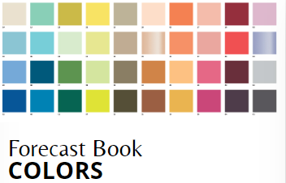
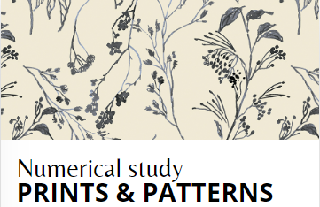

Trend forecasting agencies can be tapped to provide forecast the upcoming trends using industry data
Forecasting Agencies
Many Brands have started leveraging trend forecasting agencies such as Trendstop
Promostyl is another forecasting agency which provides historic datasets for various features and categories of apparel industry.
source: Trendstop.com, https://promostyl.com/accueil-mode/?lang=en

Slide 14
GAP, Banana Republic, Old Navy:
Are there any differences/similarities?

Slide 15
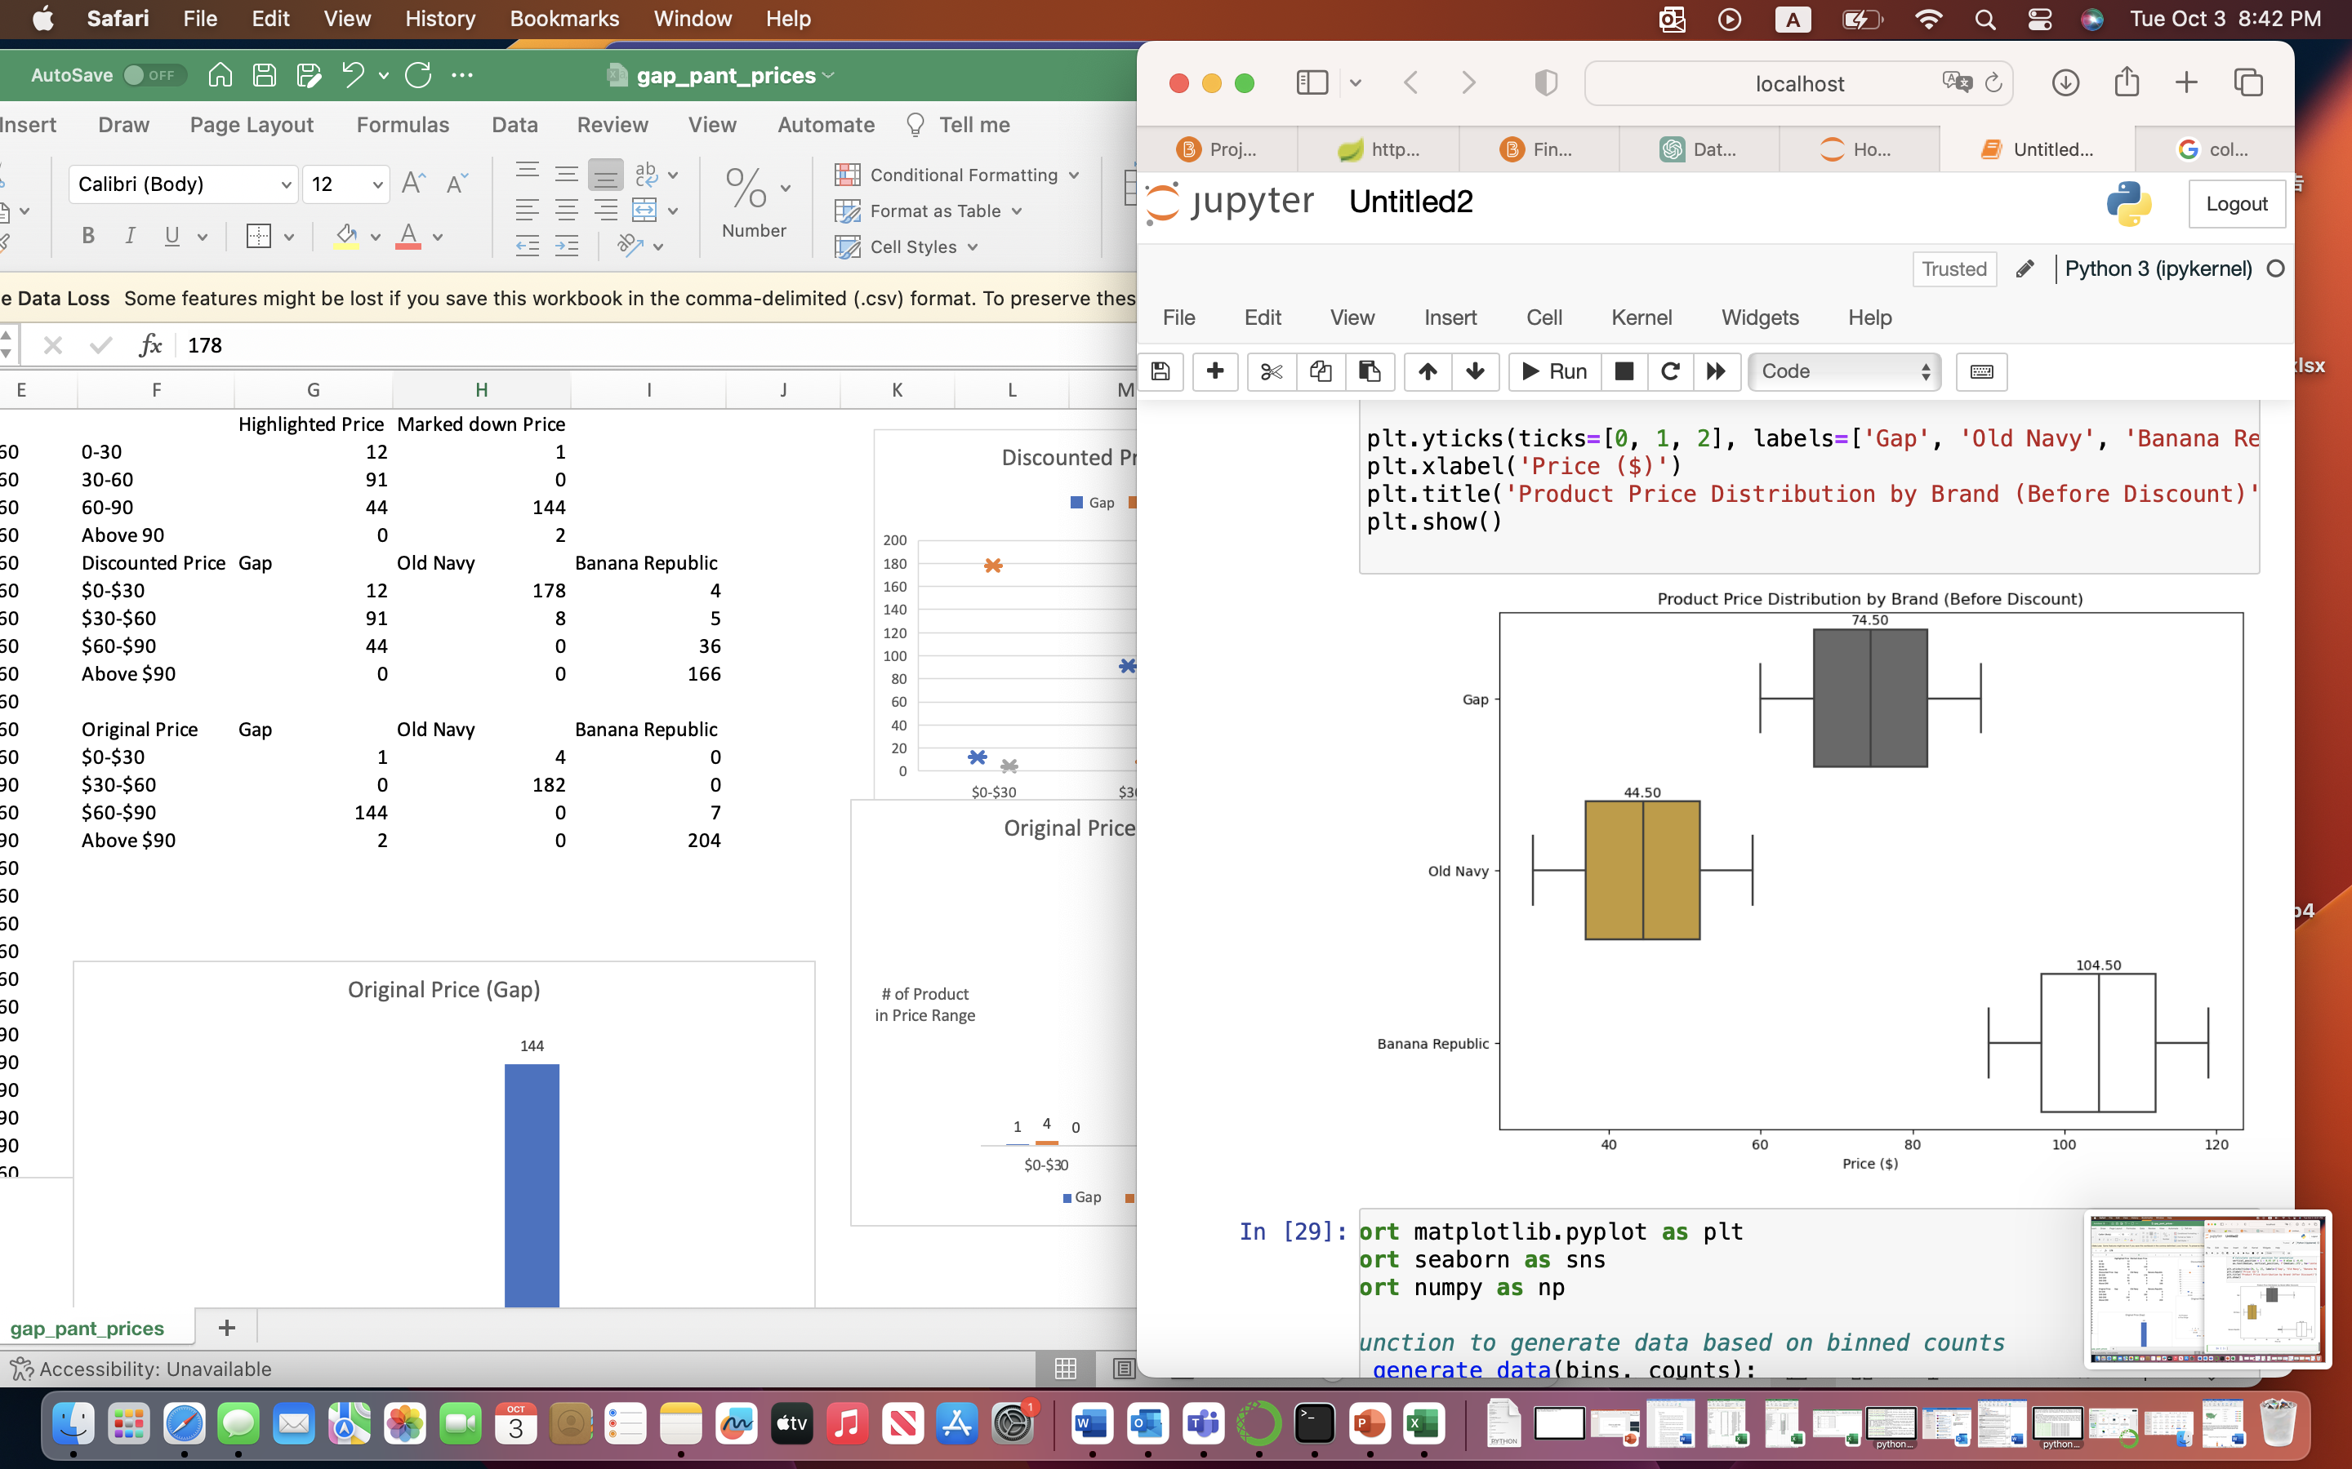
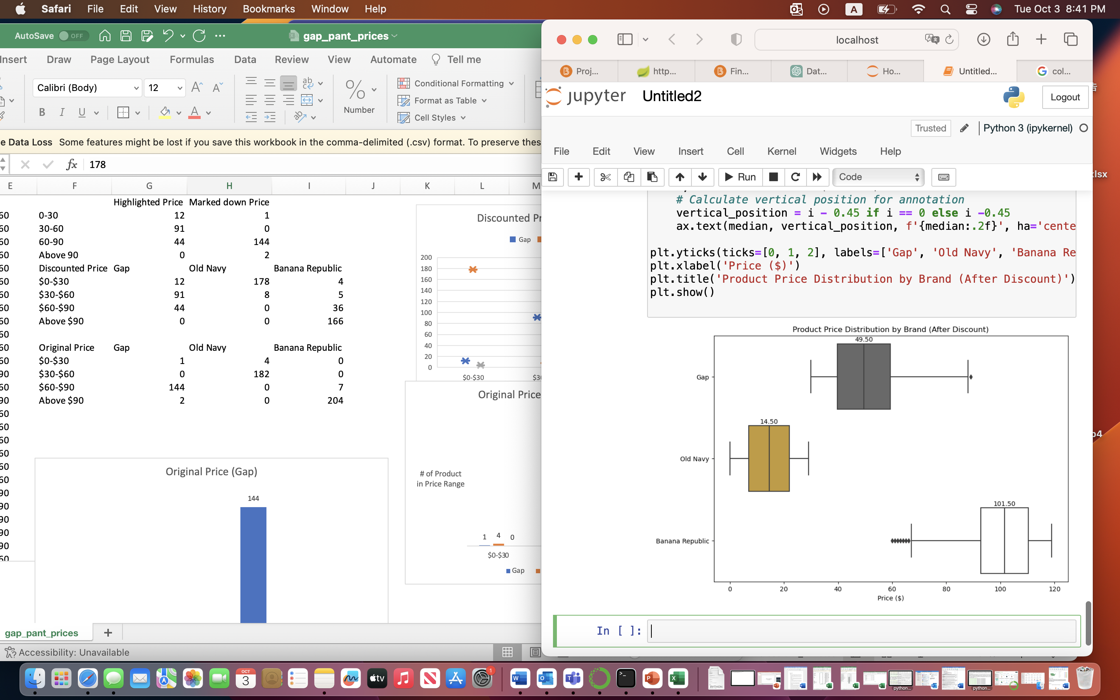
Each brand of GAP Inc. caters to the demand of a specific customer base
Price Point Analysis
The price point varies significantly for the three brands. Customer might expect to get better designs in Banana Republic due to higher prices when comparing to GAP and Old Navy.
Old Navy customer, on the other hand, might want to get the most comfortable product with the cheapest price, so they don’t need lots of creative designs.
source: gap.com, bananarepublic.gap.com, oldnavy.gap.com/

Slide 16
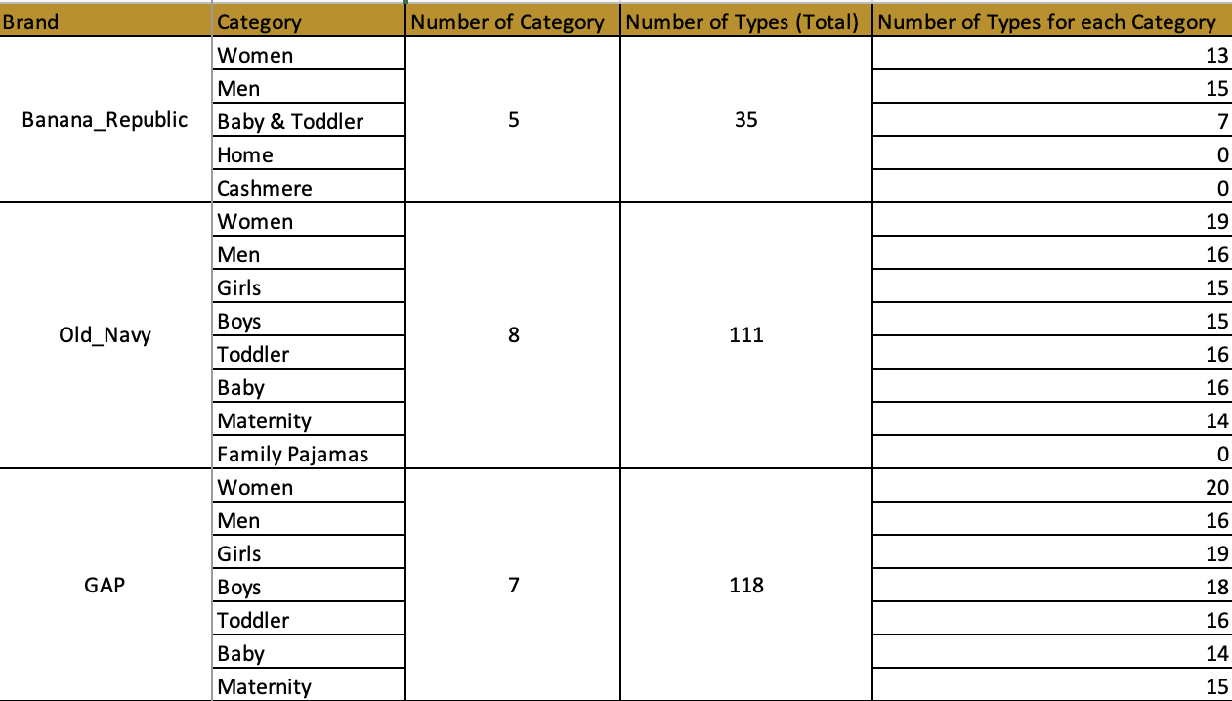
Types and Categories
Therefore, the product offerings are different
Old Navy and GAP has relatively more categories and types of clothing, while Banana Republic has limited categories and selections.
Data for Banana Republic can be limited, so using big data approach alone might not work for Banana Republic.
GAP and Old Navy have categories for Girls and Boys (wider age range), but Banana Republic only offers products for Women and Men.
source: gap.com, bananarepublic.gap.com, oldnavy.gap.com/

Slide 17
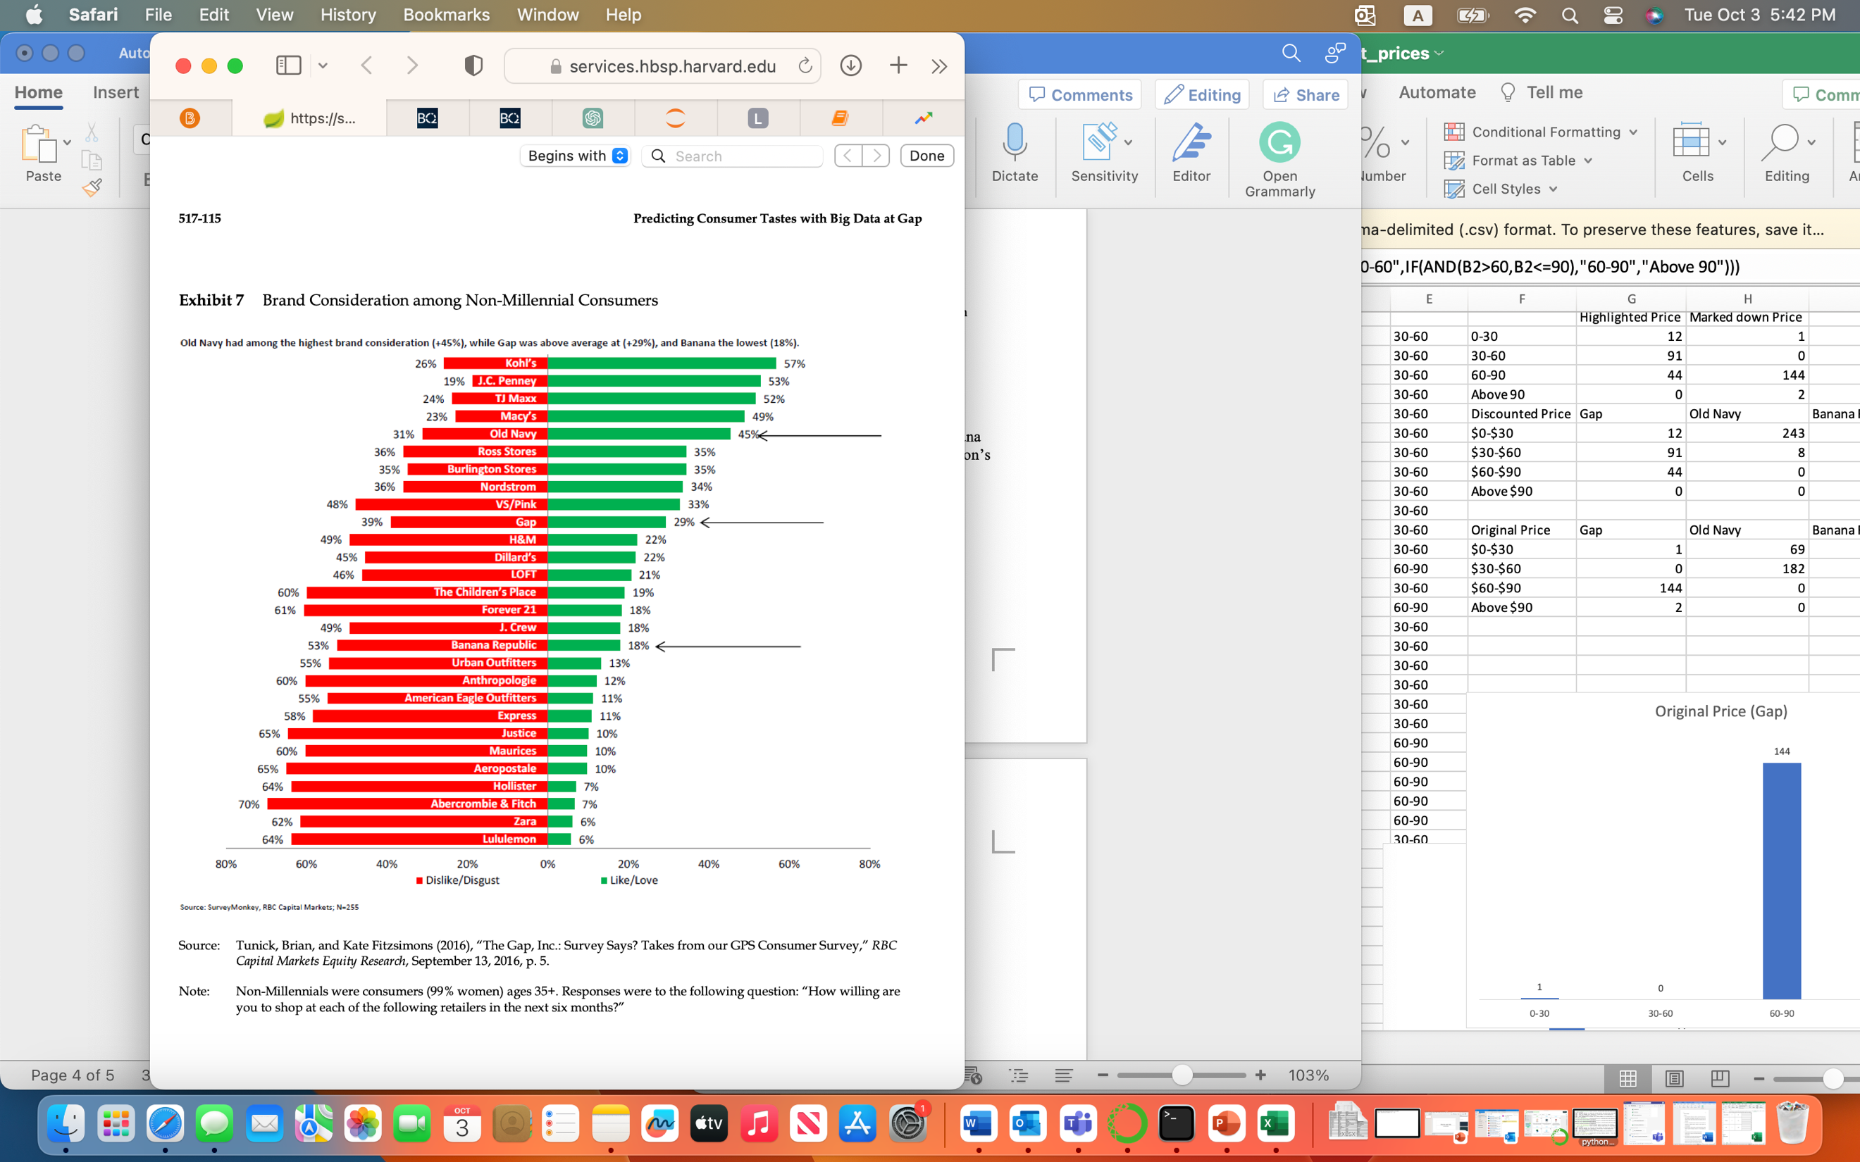
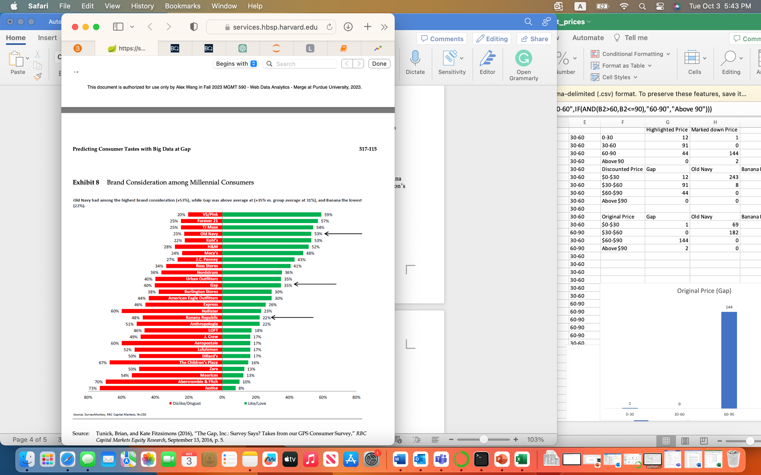
Case Point
Millennial and Non-Millennial customers' preferences
Old Navy is liked among both millennial and non-millennial customers. Banana Republic and GAP are more disliked for both millennial and non-millennial customers. Everyone likes cheap and basic clothes, big-data approach can work out well for Old Navy. In contrast, GAP and Banana Republic will need more creative designing comparing to Old Navy.

Slide 18
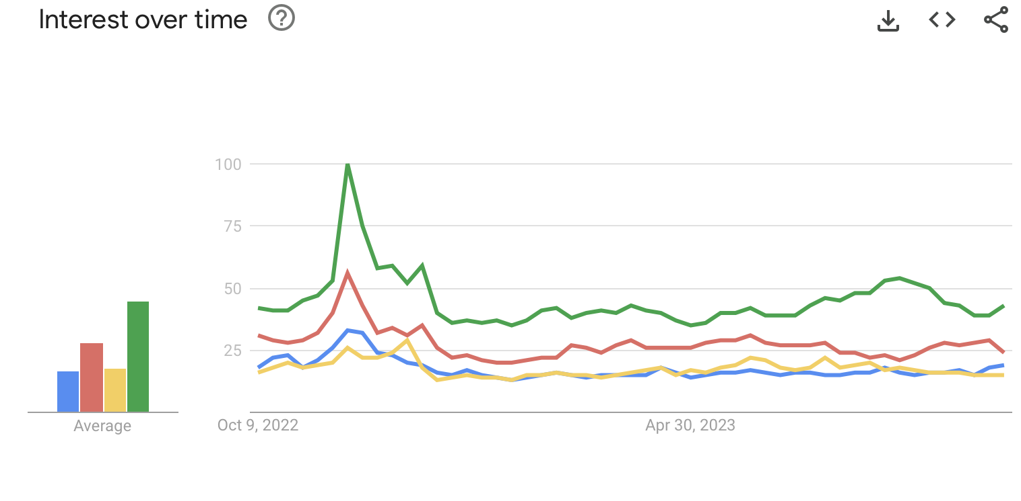
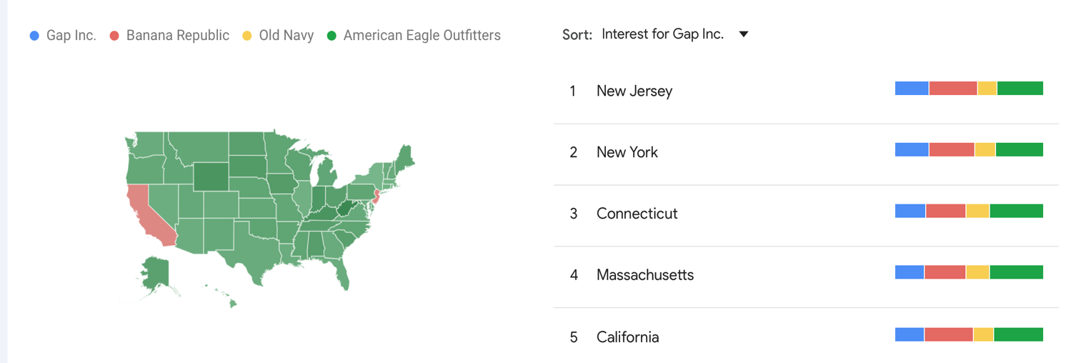
Brands Popularities
Google Trends shows the difference in terms of Popularity
American Eagle is the most popular over time. Then is Banana Republic. GAP and Old Navy are not as popular as the other two.
We can see that product price can be directly proportional to what people tend to search and the popularity.
In conclusion, these analysis shows Old Navy will need more data-driven processes, while Banana Republic relies more on creative designing, and GAP falls in a more balanced position.

Slide 19
Gap Inc.: What is the way forward?
Aid the creative directors with big data approach to find the perfect combination of human creativity and data
Given the uniqueness in the brand proposition of the three brands, build a tailored strategy in accordance with the consumers and products
Increase social media presence to be able to capture more data, hence driving digital transformation
Partner with more ecommerce platforms to cater to the current digital age consumers and expand customer reach
Use big data approach for consumer analytics, inventory optimization and predictive modelling to improve business across verticals
Use art in creative concept development, brand storytelling and in disruptive decision making

Slide 20



Limitations, Challenges and Assumptions
Limitations
Challenges
Assumptions
No access to internal sales or consumer data to expand the scope of the analysis
Restricted access to social media sentiments across Twitter or Instagram
The sample data scraped is indicative of the general trends across consumers, products and geographies

